Slide 2
How to test more men Highlights from the “Men & HIV Forum”
Lynne Wilkinson
International AIDS Society
Gender matters: How gender-transformative approaches are changing the HIV response
Tuesday, 23 July
Notes:
Good afternoon ladies and gentlemen, I have the arduous task of attempting to summarise in 5 minutes a full day forum that was held as pre-conference on Men & HIV on Saturday with 150 participants from civil society, ministries of health, implementers, researchers, global normative agendies and funders.

Slide 3
Why a “Men & HIV Forum”?
48%
60%
Living with HIV
Globally, 48% of adults living with HIV are men
Aids-related deaths
Globally, 60% of Aids-related deaths happen among men
2018 data, Among people 15+ years of age, http://aidsinfo.unaids.org/
Notes:
Men need our focus as they make up less than half of people living with HIV but account for 60% of HIV related mortality. The forum avoided framing men as a problem and focused on reaching men to improve men’s health as an end in itself

Slide 4
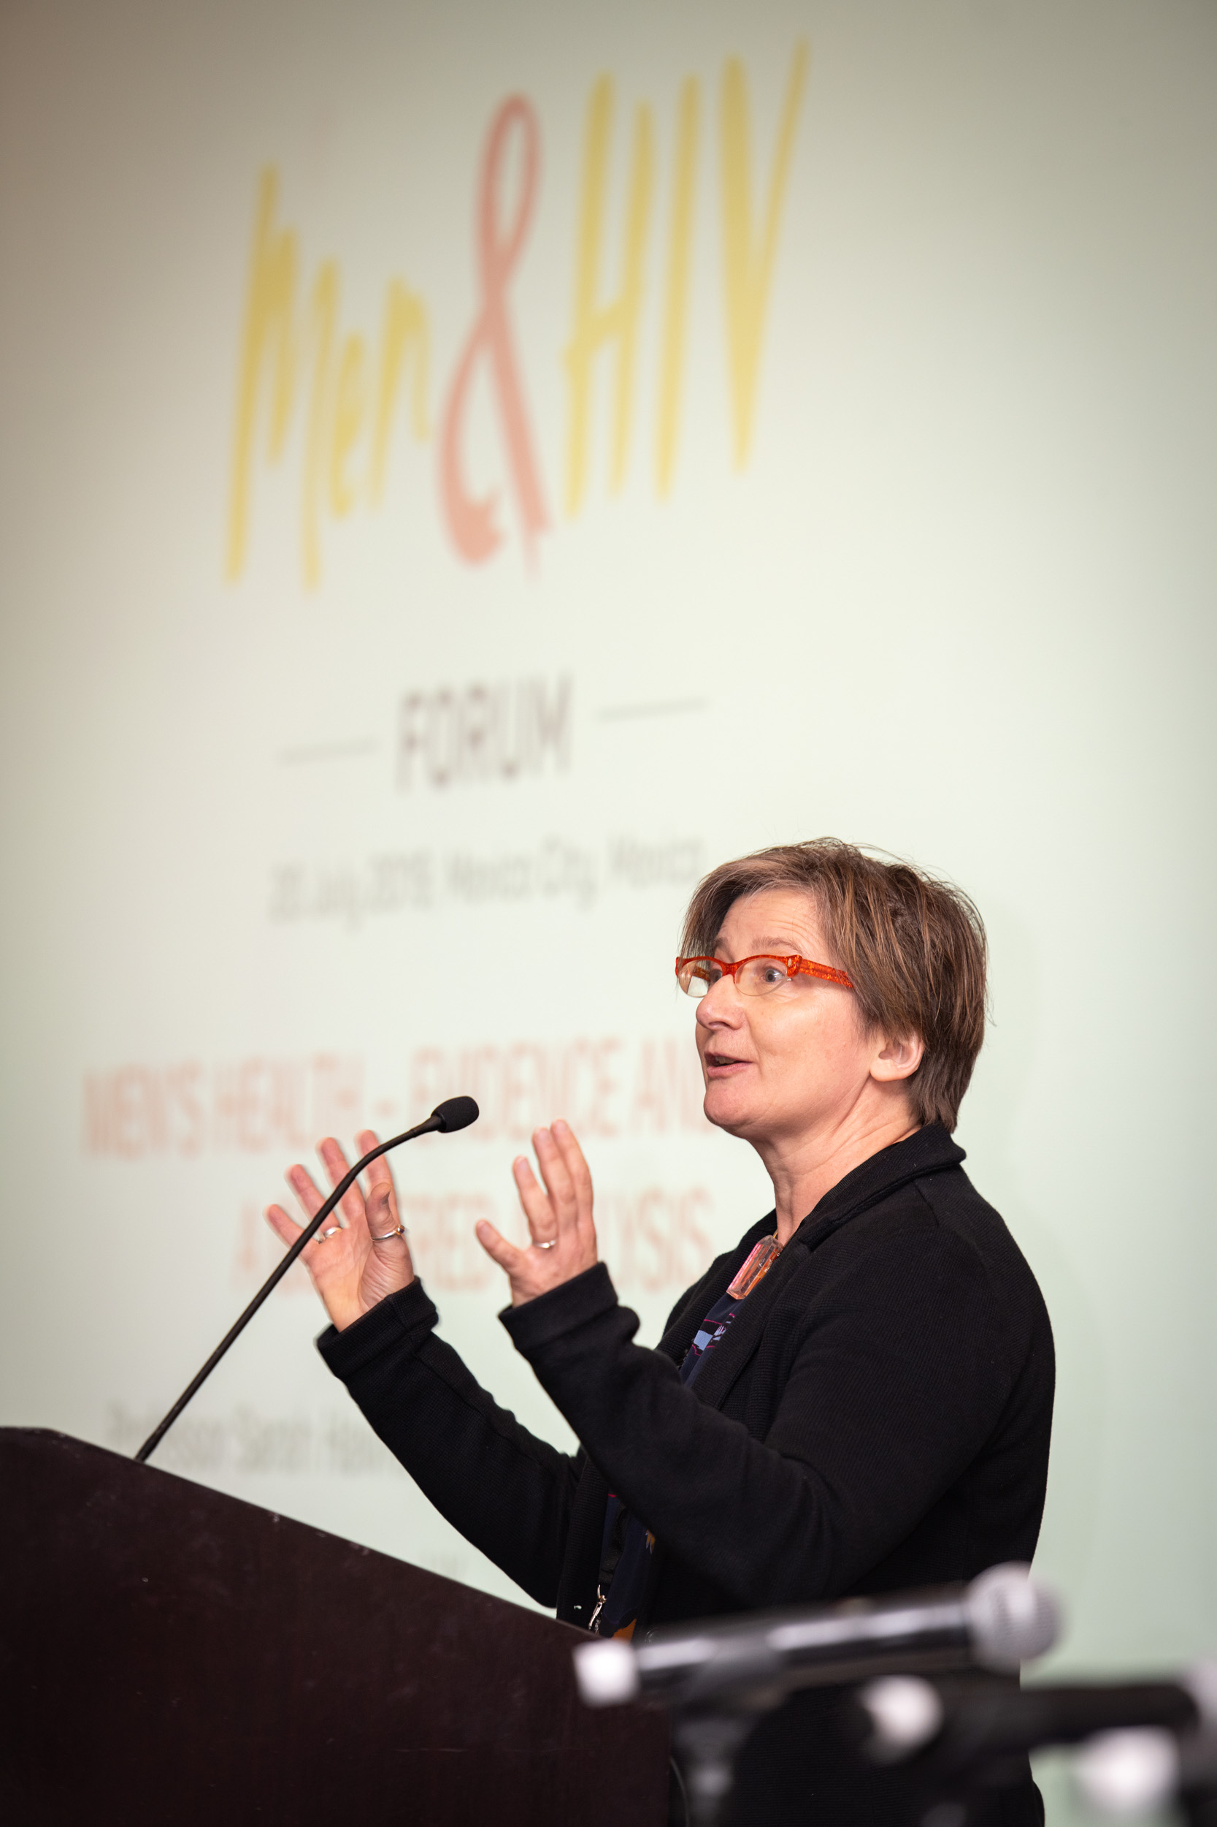
Essential change required to address men’s health Prof Sarah Hawkes
From women vs. men to inclusivity and universality
From sex-disaggregated data to gender analysis
From evidence-informed to politically informed health policies
Notes:
Professor Hawke spoke about what is needed to improve men’s health and identified 3 key areas:
We need to stop talking about men vs women or men or women, talk about inclusivity and universality - shared risks, determinants and benefits of all of the work that we do.
Away from sex disaggregated data to a gender analysis to understand why you’re seeing these differences
Understanding that public health is a political process - driven by politics rather than evidence – we need to adjust our strategies to influencing the political paradigm.

Slide 5
ART coverage (>15 years), global and regional, 2018
UNAIDS, 2019, Communities at the centre
Notes:
We reflected on the new UNIADS report that shows the disparity in ART coverage between men and women – most stark in African regions – only the region we are meeting in today shows close to equal ART coverage between men and women.

Slide 6
"We saw it in Botswana - you can get to 90-90-90 with a femininized approach, you haven’t reached the men.” Ambassador Birx
Notes:
Ambassador Birx presented PEPFAR data and showed how you can reach 90-90-90 with a feminized approach - BUT you haven’t reached men. These are PLHIV unreached by testing treatment or viral suppression in Botswana

Slide 7
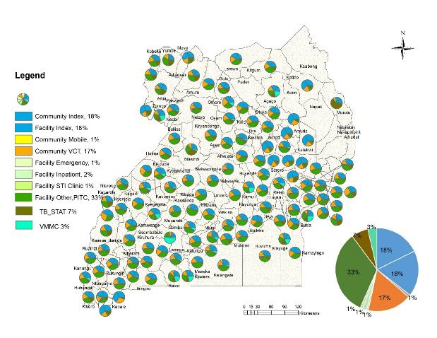
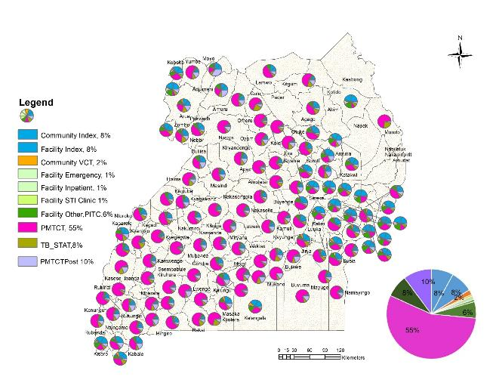
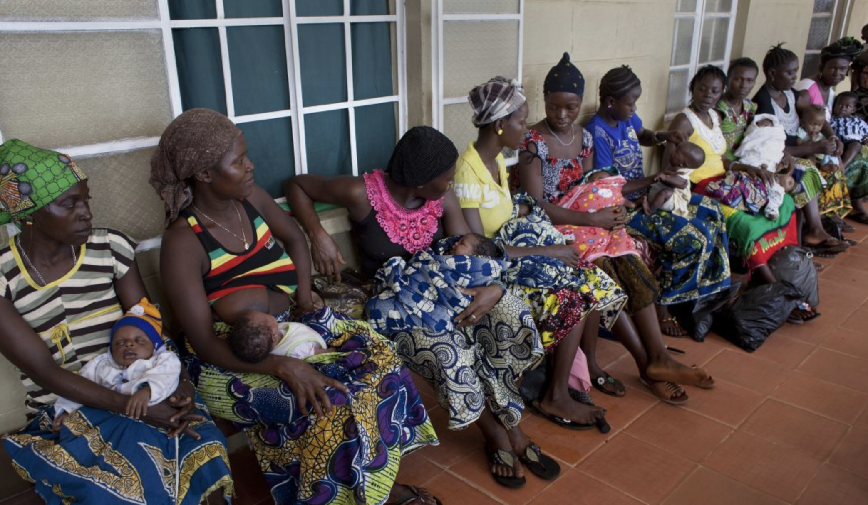
Gendered health system Where do we diagnose men?
Proportion of Males 15+ identified by modality
Proportion of Females 15+ identified by modality
33% of men identified within TB
55% of women identified within ANC
Notes:
Further PEPFAR data from Uganda showed where we diagnose men – 33% in TB services – late in their disease progressions compared with 55% of women identified through ante-natal services.

Slide 8
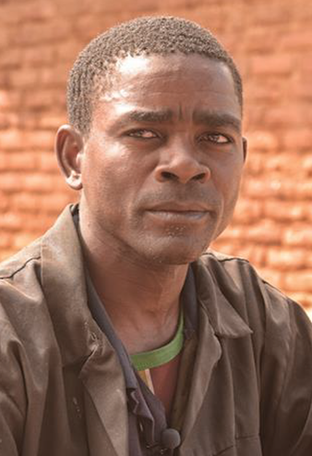
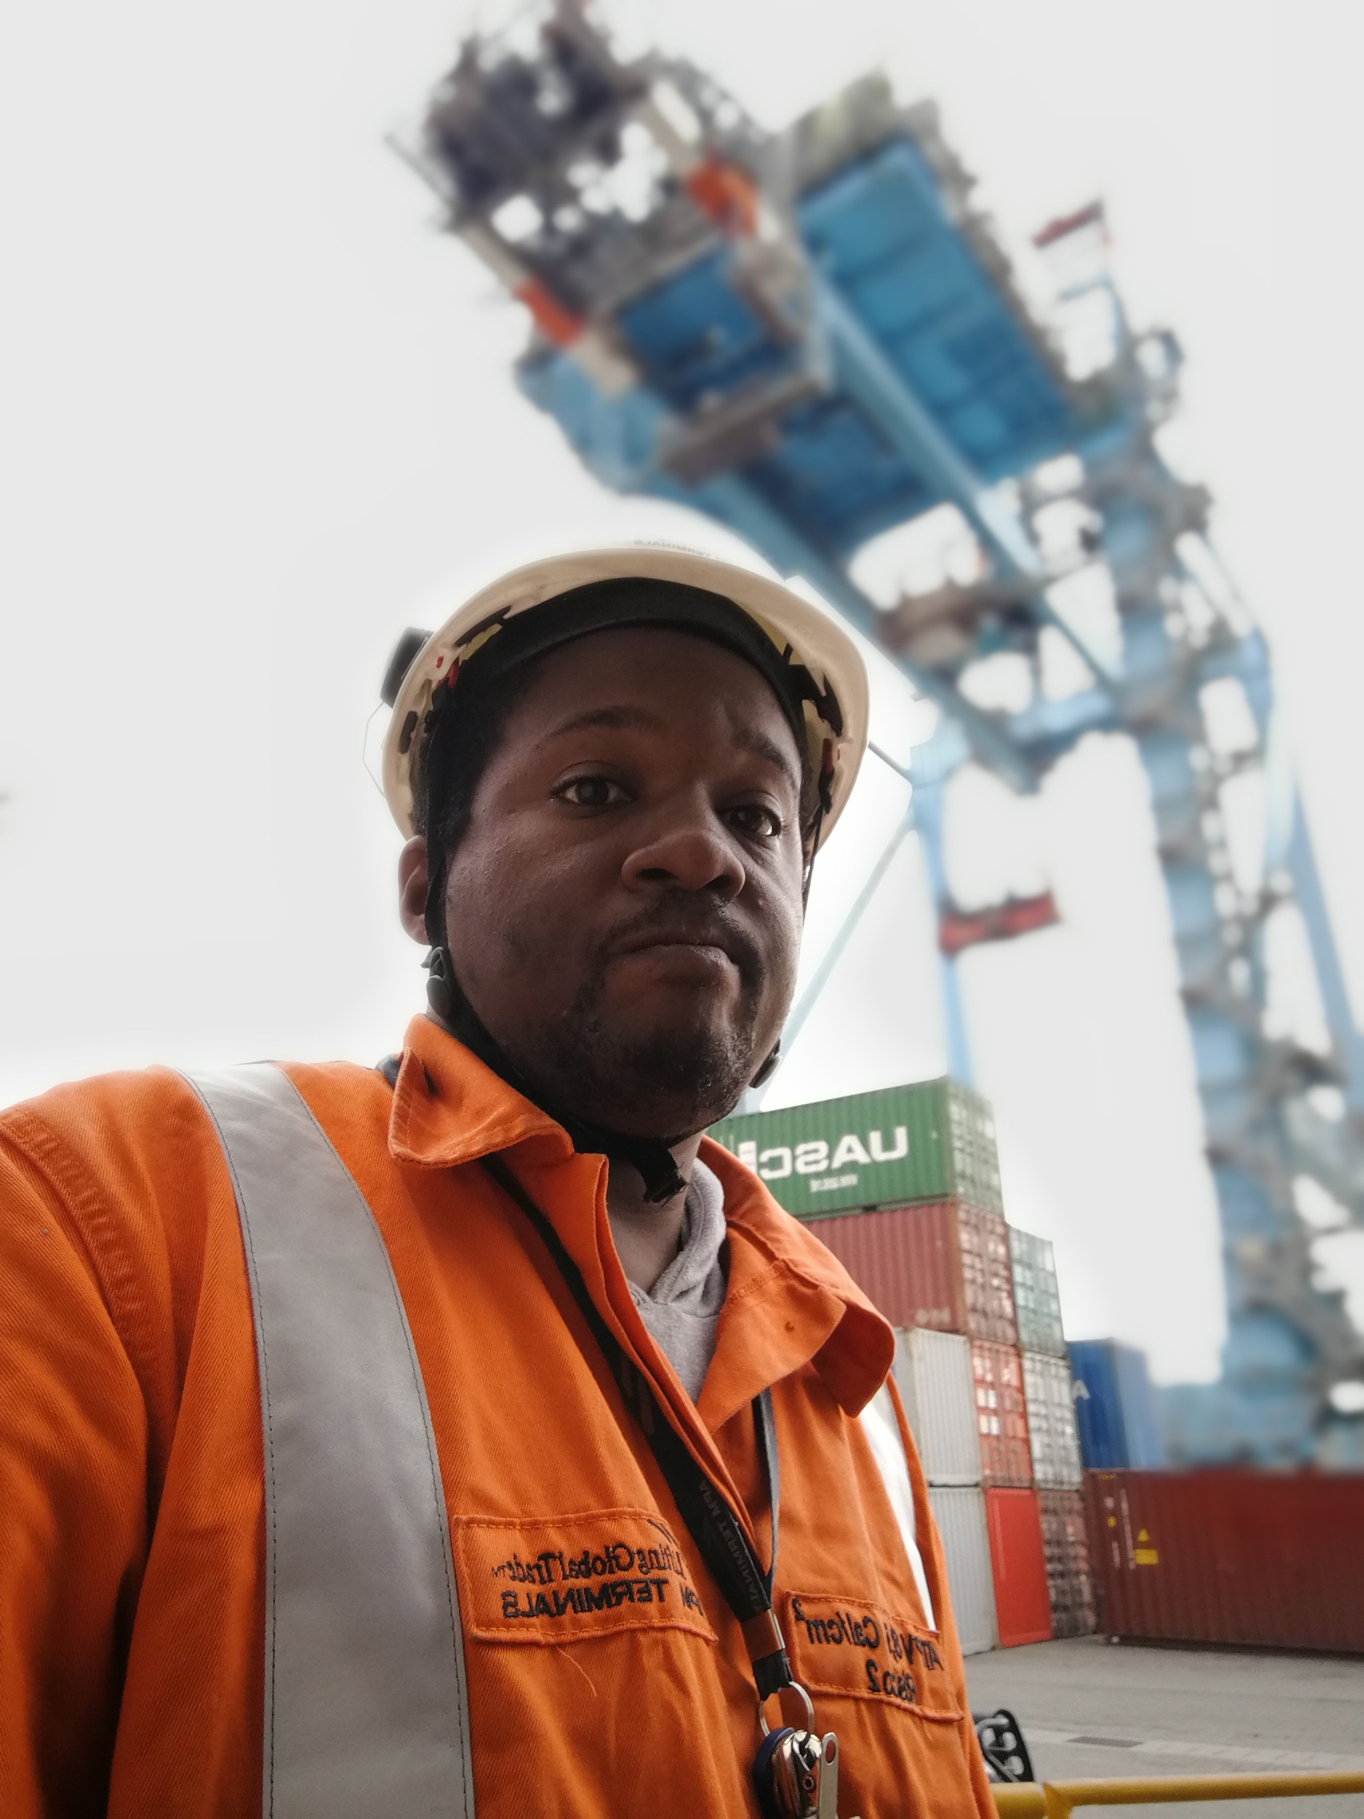
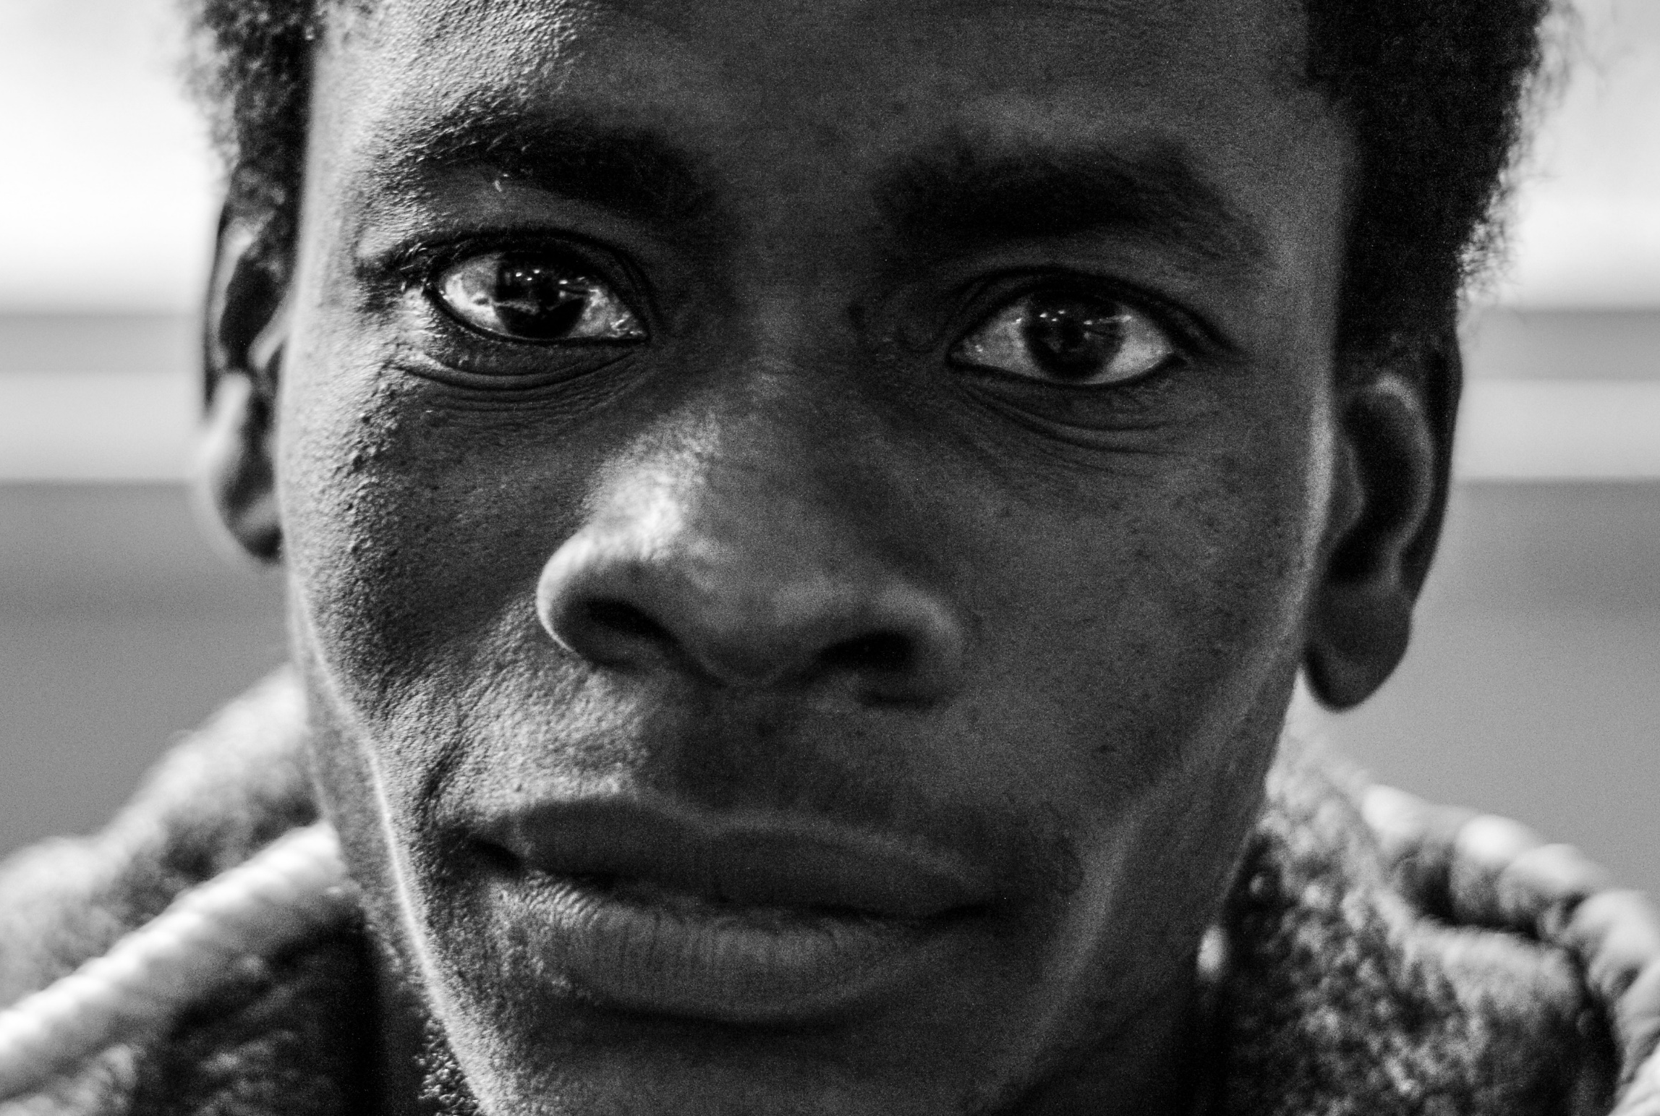
There isn’t a single “ MEN” population There’s are different men with different needs
Mr Grey
Mr Teal
Mr Rose
Mr Blue
Mr Green
Notes:
The day moved on to reflect extensively on studies and experience that showed there isn’t a generic population which we can identify as men “the men”. There’s different men with different needs – many of whom are not hard to reach. Shaun Malone from PSI and their partners showed how the particularly hard to reach group of men (Mr Green) only make up 18% of the male population in South Africa. These men will need extra support and we could look to KP services for lessons and best practises.

Slide 9
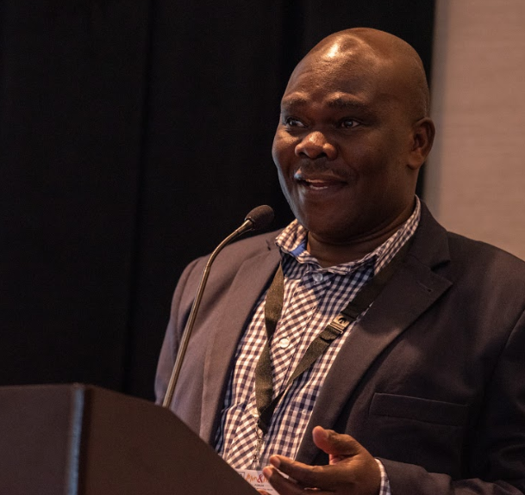
To improve men’s health
Empower men in communities with information:
U=U
Clinic services
Pathway ahead
Create demand among men for health services
Adapt health services for men
Nelson Otwoma
NEPHAK, Kenya
Notes:
We discussed the 2 pieces of the puzzle – creating demand for health services for men and how dependent this is on equally providing men with information (not only women when they visit our facilities) – important information which men do not have include the benefits of U=U, what clinic services look like ( what to expect when you walk into a clinic – many men have not visit since they were immunized as children and fear the unknown, what the treatment pathway ahead looks like.

Slide 10
To improve men’s health
Service delivery for men What do they want?
WHEN | Outside of traditional service hours
WHERE | Within communities - where they are
WHO | Access to male service providers
WHAT | - HIV services within wellness health services - HIVST
Create demand among men for health services
Adapt health services for men
Notes:
The second piece of the puzzle involved how we adapt health services for men - the common building blocks that came out from country best practices and research studies are reflected here:

Slide 11
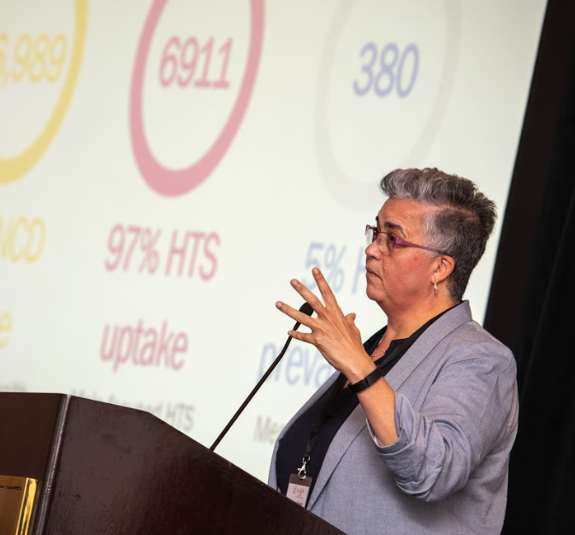
To improve men’s health
Service delivery for men What do they want?
WHEN | Outside of traditional service hours
WHERE | Within communities - where they are
WHO | Access to male service providers
WHAT | - HIV services within wellness health services - HIVST
Create demand among men for health services
Adapt health services for men
<10% utilization before noon
Peak utilization (59%) after 3pm
Zwakala Ndoda
Heidi van Rooyen, HRC
Notes:
WHEN: Zwakala Ndoda: <10% utilization before noon, Peak utilization (59%) after 3pm
MSF, PopART and Lesotho Ministry of health men’s clinic provided extended and weekend hours – policy barrier!

Slide 12
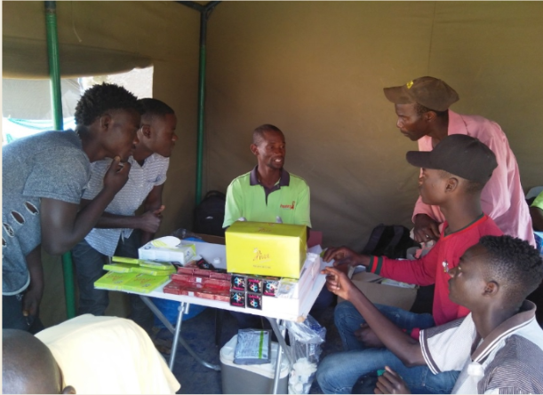
To improve men’s health
Service delivery for men What do they want?
WHEN | Outside of traditional service hours
WHERE | Within communities - where they are
WHO | Access to male service providers
WHAT | - HIV services within wellness health services - HIVST
Create demand among men for health services
Adapt health services for men
Community hubs
Taxi ranks
Mobile services at places where men meet
Notes:
WHERE: Minority of clinic attendees are men & community doesn’t mean door-to-door (popART: 23% men not contacted compared to 10% of women)
PopART, MSF and Zwakala Ndoda successfully provided community testing for men at communit hubs, mobile testing stationed at men focused community venues and in taxi ranks

Slide 13
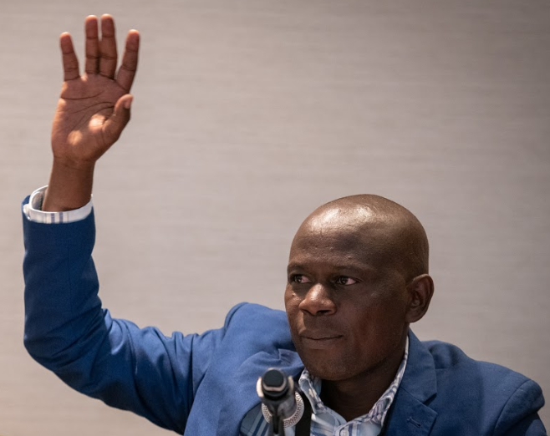
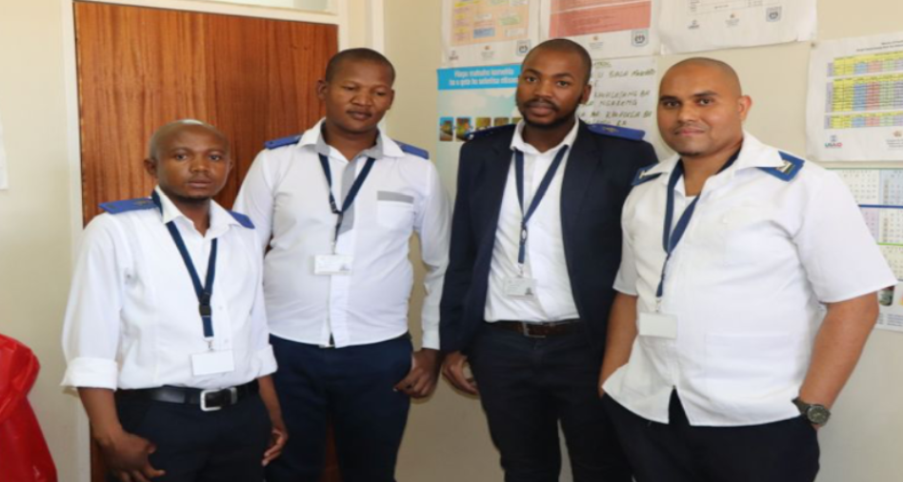
To improve men’s health
“Men listen to fellow men as peers”
Philip Nyakwana
Movement of men against AIDS, Kenya
Service delivery for men What do they want?
WHEN | Outside of traditional service hours
WHERE | Within communities - where they are
WHO | Access to male service providers
WHAT | - HIV services within wellness health services - HIVST
Create demand among men for health services
Adapt health services for men
Notes:
WHO – all studies found a segment of men wanted to be serviced by male service providers - Men need to hear from other men. Cause they’re more likely to hear men.

Slide 14
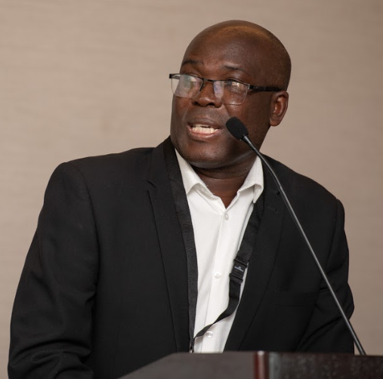
To improve men’s health
Intervention provided HIV testing services within broader health service as indicated by formulative work
Dr Musondo Simwinga
Zambart, Zambia
Service delivery for men What do they want?
WHEN | Outside of traditional service hours
WHERE | Within communities - where they are
WHO | Access to male service providers
WHAT | - HIV services within wellness health services - HIVST
Create demand among men for health services
Adapt health services for men
Notes:
WHAT: best practices found that men preferred HIV services integrated within other wellness or sexual health services
And for testing specifically valued the availability of HIVST for testing more confidentially in their own space with those they choose for support.

Slide 15
To improve men’s health
Create demand among men for health services
Adapt health services for men
Notes:
All presentation made throughout the day are available on the DSD website – a meeting summary will be available shortly

Slide 16
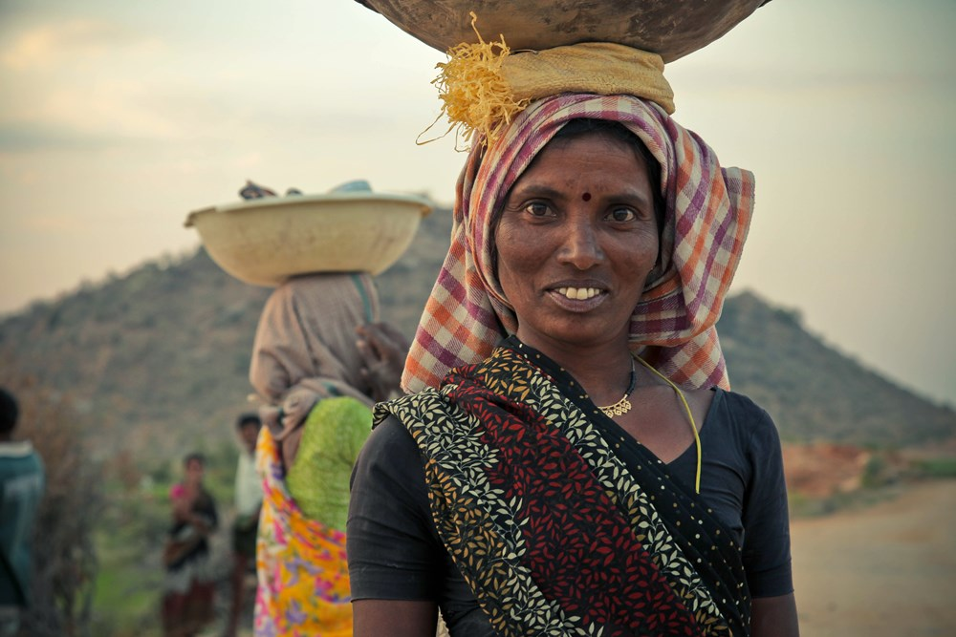
www.differentiatedservicedelivery.org
Notes:
All presentation made throughout the day are available on the DSD website – a meeting summary will be available shortly

